Slide 1
unclassified
Team Minerva
16 Apr 2021
Accelerated, INTERACTIVE, and ACTIONABLE sentiment analysis
unclassifiEd

Slide 2
JSOC/JIATF-NCR EOP 2021 DATA CHALLENGE
Highlights of the Event
Wildfire is an excellent and functional data science environment
Good mix of freedom and security with Jupyter Lab on docker implementation
Ability to rapidly customize our environment a big plus
Slack Channels
Defined slack channels helped interaction with Mentors and Organizers
Technical support and documentation using Slack, Confluence worked well
Collaborative Competition Encouraged Team Interactions
Collaboration with multiple teams, organizations, people around the globe
Shout out to forward deployed folks helping out
Encouraged interaction and code sharing

Slide 3
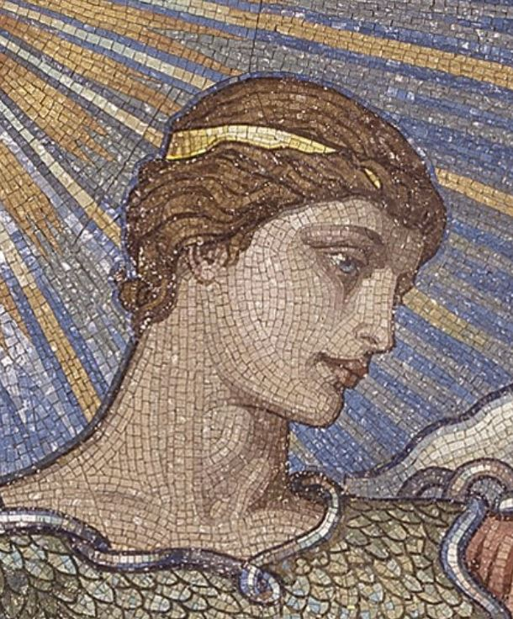
TEAM MINERVA
Diverse Team Support the Defense Intelligence Agency (DIA)
Comprised of:
Active-Duty Military
Government Civilian
Senior Engineering Technical Advisor (SETA) Contractors
Industry Contractors, large and small companies
All experience levels, analysts, developers, and data scientists
No Lanyard Environment
One Team One Mission
Aspirational Mission
Expand Machine Learning adoption and use for DIA and Mission Partners, and Partner Nations
Minerva – the Greek goddess of Wisdom and Military Strategy

Slide 4
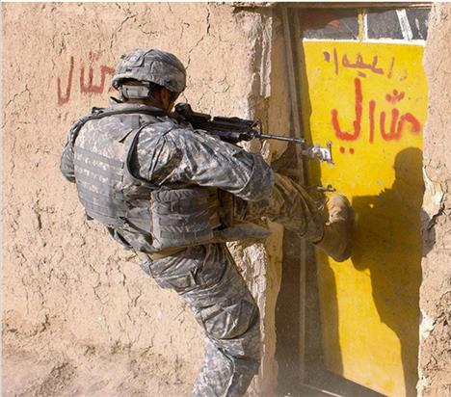

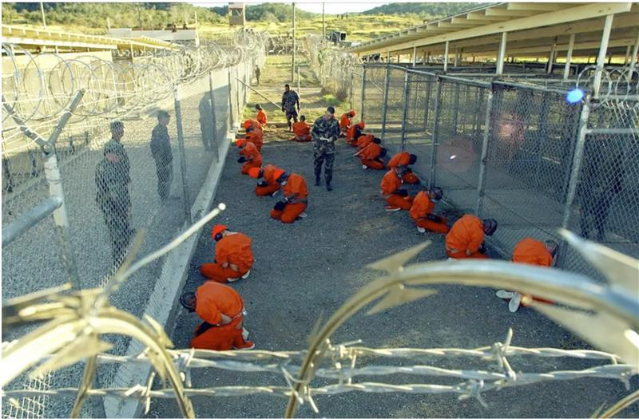
Objective
Team Minerva focused on rapidly delivering analytics and data to the analysts. Providing this in an interactive user experience allows for enhanced understanding, experimentation, and trust, for both the data and the analytics. We leveraged machine learning to speed up and enhance the quality of document processing and analytic development to accelerate mission action.
Our Goal: Reduce intelligence creation times and increase intelligence product confidence, speed, and impact.

Slide 5
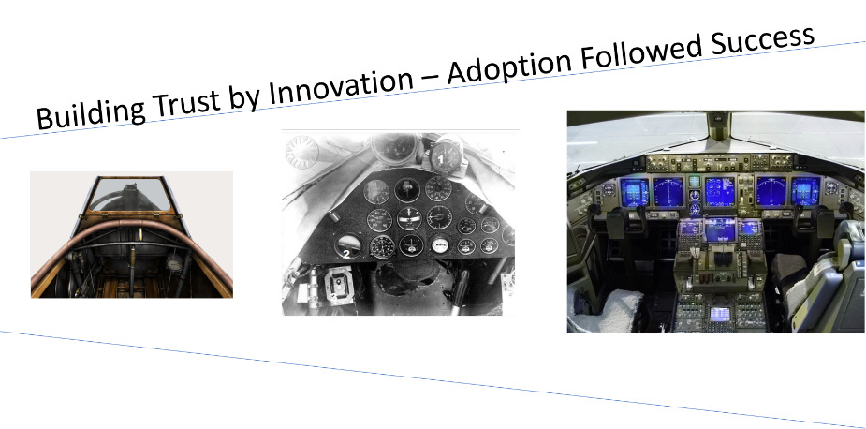
Overview
Intelligence analysts are intelligence creators, not data consumers
Let’s put, analytics in the hands of the analyst
Enable full exploration of data and model
Drill-down into the data
Building Trust in Machine Learning
1929: Jimmy Doolittle builds trust in instrument flying by “flying blind”
Fifty years later flying blind is routine
Bias detection and Adversarial Data Attacks
Open-Source Artificial Intelligence Fairness (AIF)
Identifies bias within data sets and algorithms
Continuous data, algorithms, and models
Data growth - volume, velocity, and variety
Models need to be continuously updated, trained, optimized, and scaled

Slide 6
SCOPE
Data Processing
Data pipeline (parsing, cleaning, normalizing)
Translation
External Web Service connectivity to translate Arabic to English
Topic modeling
Automatic clustering of word groups and similar expressions, to characterize sets of documents
Identification and removal of uninteresting documents; ranking of most interesting
Natural language processing
Categorization and identification
Sentiment analysis and toxicity analysis
Review
Analyst Iterative refinement and outlier identification and investigation
Automated Bias and Explainability
Rapid Product generation
Automated creation of User Interfaces and Reports based on data

Slide 7
DATASETS
CELLEX : Mobile Device Forensics (text)
Data Processing excel
DOMEX Consumer Data (text)
MS Word documents text extraction (English, Arabic)
PDF documents text extraction and OCR text (English, Arabic)
Open-Source Twitter Data
~60K tweets before and after recent Beirut bomb explosion

Slide 8
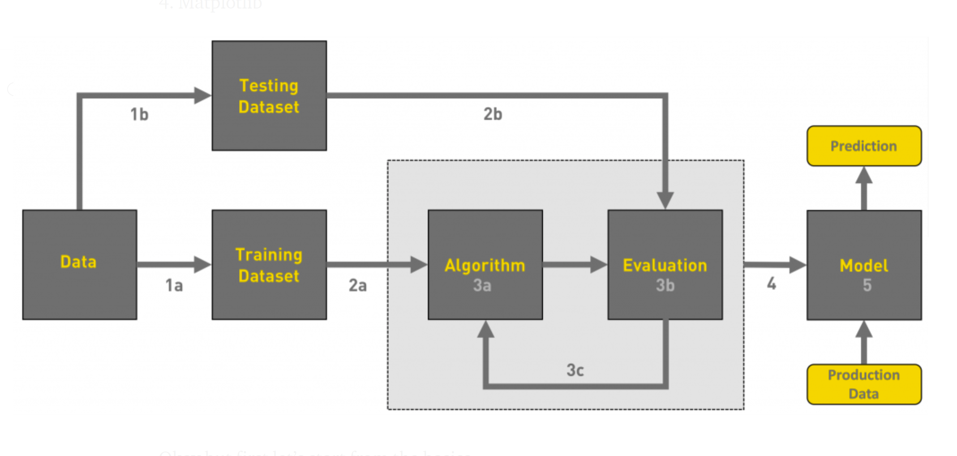
DATA SCIENCE WORKFLOW
What is the machine learning Model?
The machine learning model is nothing but a piece of code; an engineer or data scientist makes it smart through training with data. So, if you give garbage to the model, you will get garbage in return, i.e. the trained model will provide false or wrong predictions.
Gathering data
Data pre-processing
Researching the model that will be best for the type of data
Training and testing the model
Evaluation
Cotton Gin for data
Data goes in
Prediction comes out
Repeat these steps until you reach threshold accuracy
Workflow of a Machine Learning project | by Ayush Pant | Towards Data Science

Slide 9
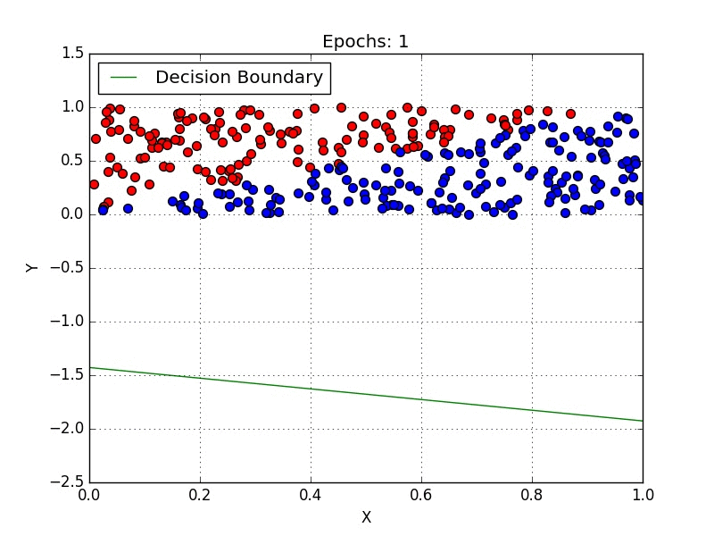
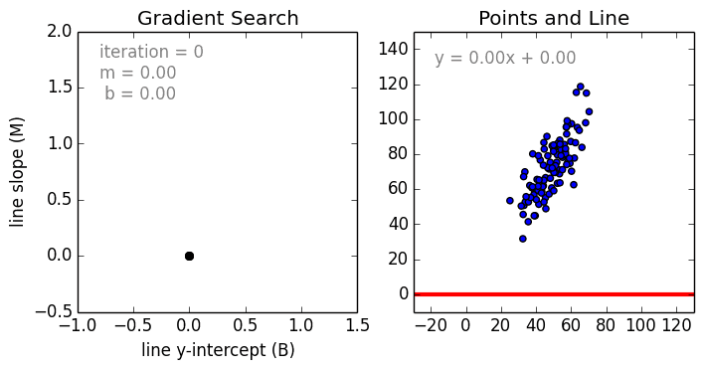
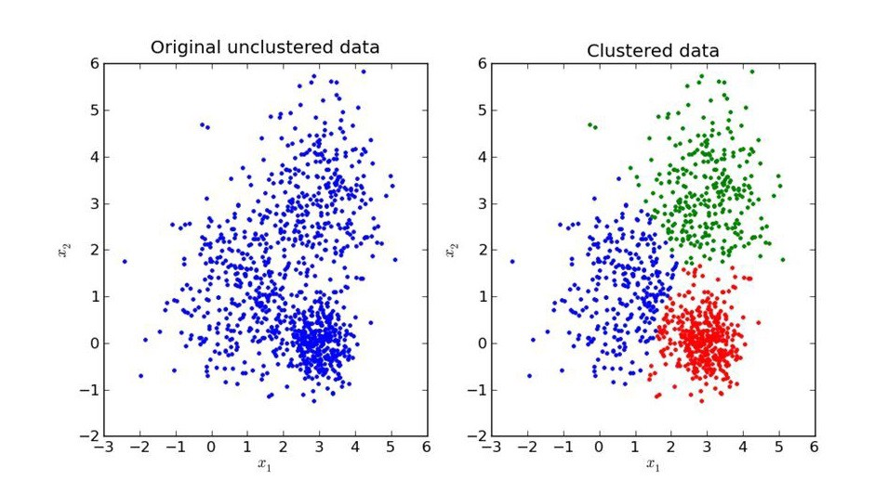
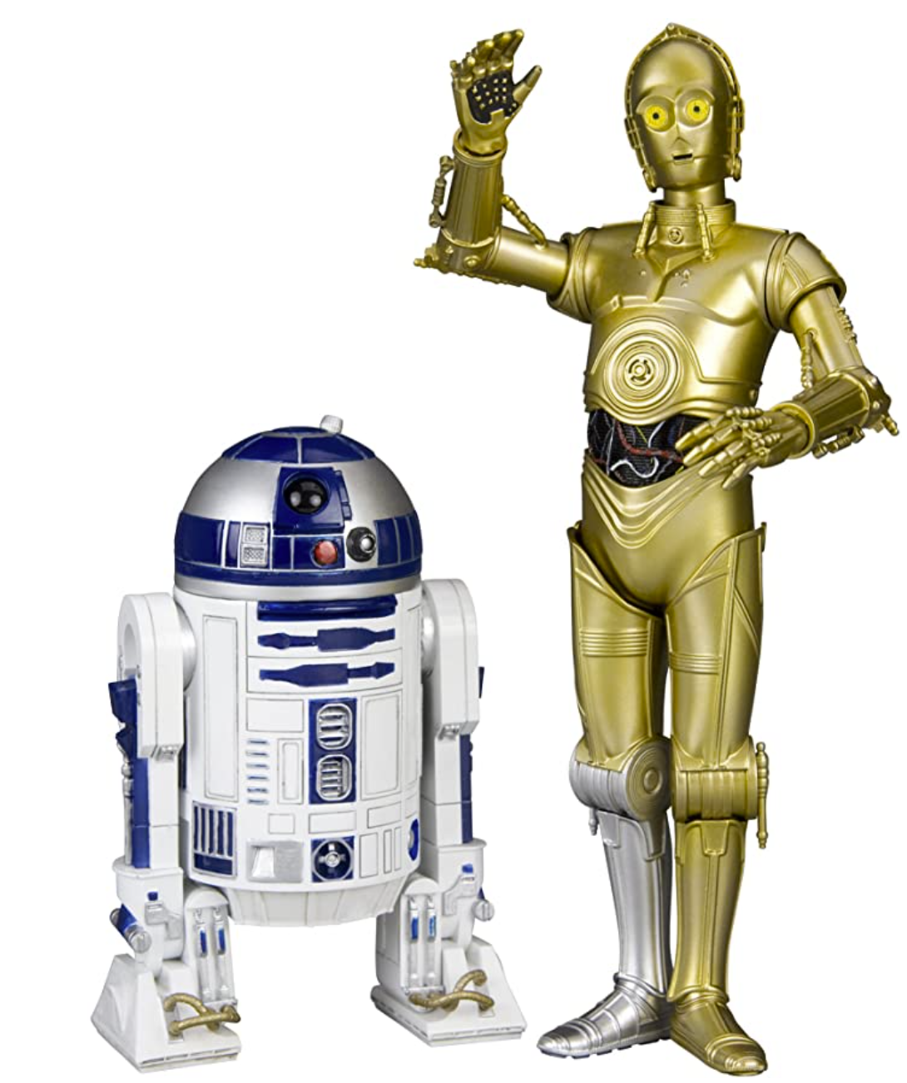
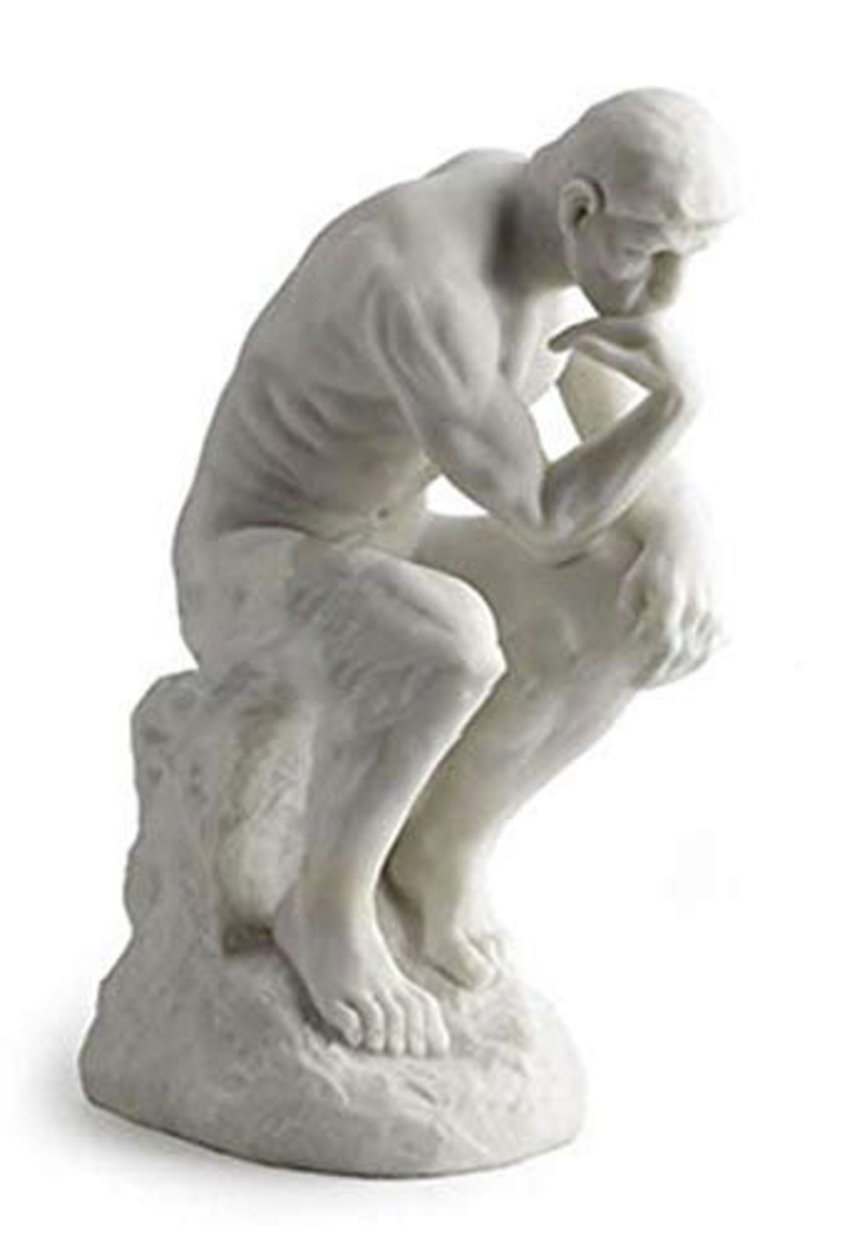
WHAT CAN A MODEL DO?
Classify
Predict
Group
What a model cannot do!
No rational human thought. The models above work on patterns, they do not “understand” the data.
Not Yet!
Workflow of a Machine Learning project | by Ayush Pant | Towards Data Science

Slide 10
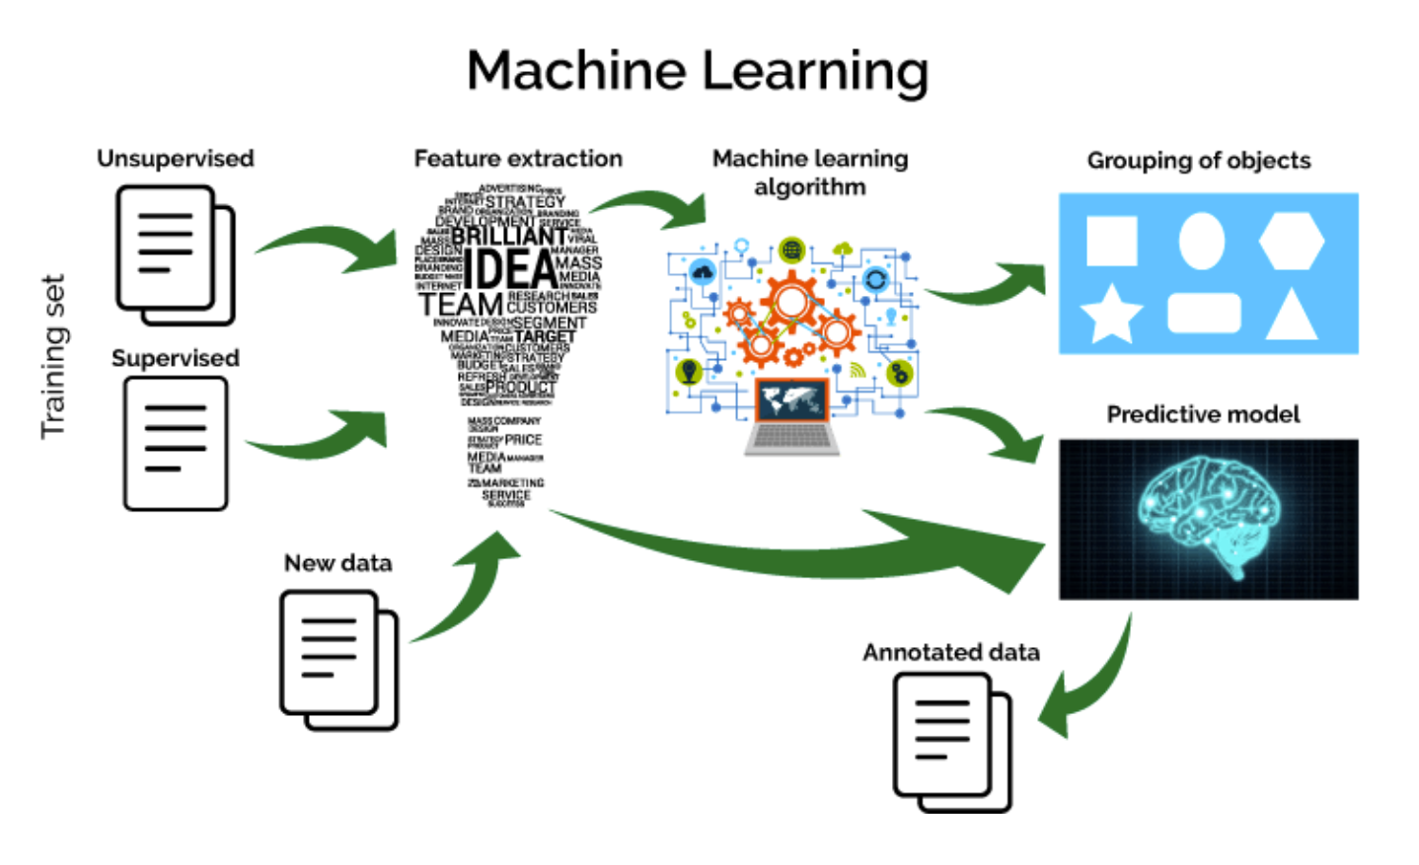
MODEL EVALUATION
Model Assessment
How well did it do on its task?
Were there any biases?
Could it be made faster?
Was it accurate?
Assess tolerance for false positives and false negatives
Adjust as needed
Workflow of a Machine Learning project | by Ayush Pant | Towards Data Science

Slide 11
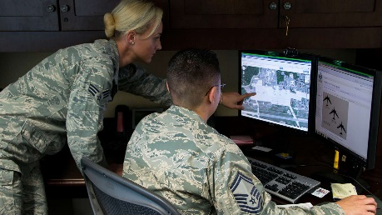
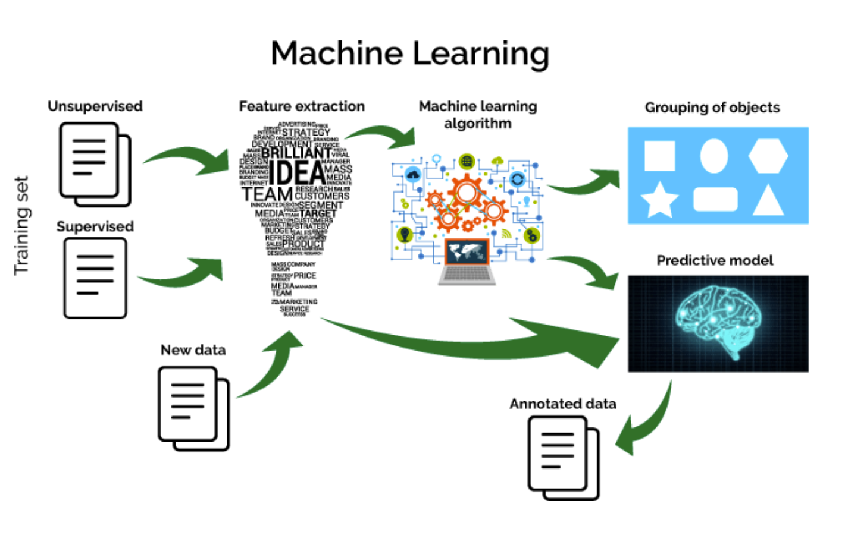
CONTINUOUS MACHINE LEARNING CYCLE
Data Capture
Data input rising
Model Generation
Automated Data Pipeline
Model Monitoring
Constant Assessment of for Accuracy, Bias, and Drift
Analyst Feedback
Human on the Loop
More sensors
More sources
IOT
Social Media
Continuous Model Generation
Continuous Model Deployment
Real-Truth feedback
Data Requirements
Product impact

Slide 12



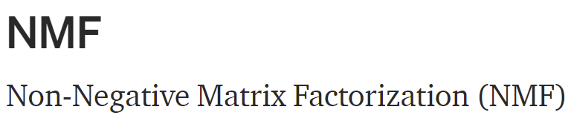





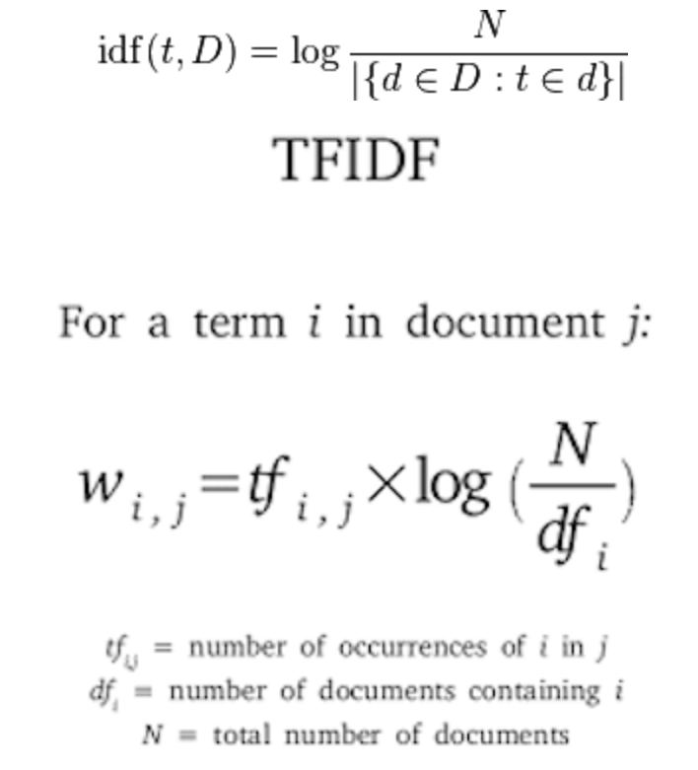


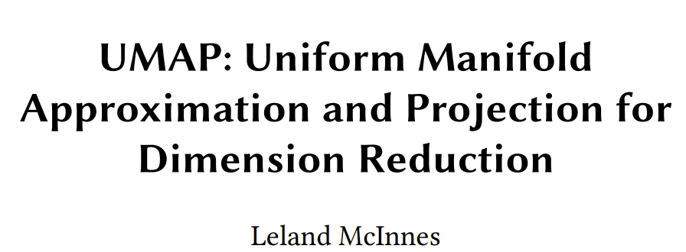

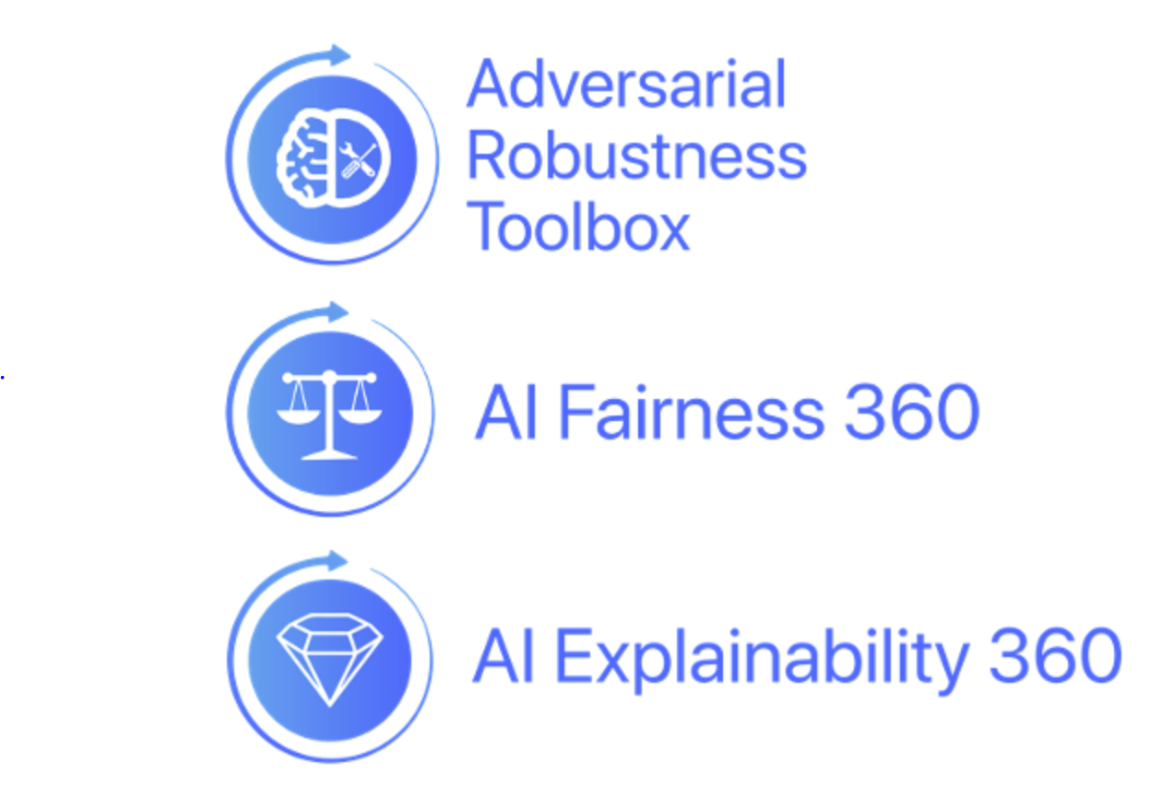

ARCHITECTURE
What we made along with what we would have liked to have made given more time
Data Pipeline
Machine Learning
Visualization
not finished
Time and resource constraints loomed large in our selection of tools
Time to real code drove most decisions
Codebase is a mix of legacy code, open-source, and licensed products
Where licensed products were used, open-source variants are identified

Slide 13
MISSION USE CASES FOR MACHINE LEARNING
Discovery, starting from an unfettered full dataset
Rapid, scalable, and portable, triage of available data types
Iterative refinement and outlier identification and investigation
Social Media as a Sensor
Leverage prior event signatures to serve as indicators
Can provide insight into closed or restricted societies for major events
Persona identification
Correlating language patterns and content similarity, to identify persons
Essential Elements of Information (EEI), associated with persons/actors
Campaign identification and classification
Intent, sentiment, emotion scores (fear, anger, joy, disgust…), and toxicity
Categorize into positive, negative, or disinformation, as per Request For Information (RFI)

Slide 14
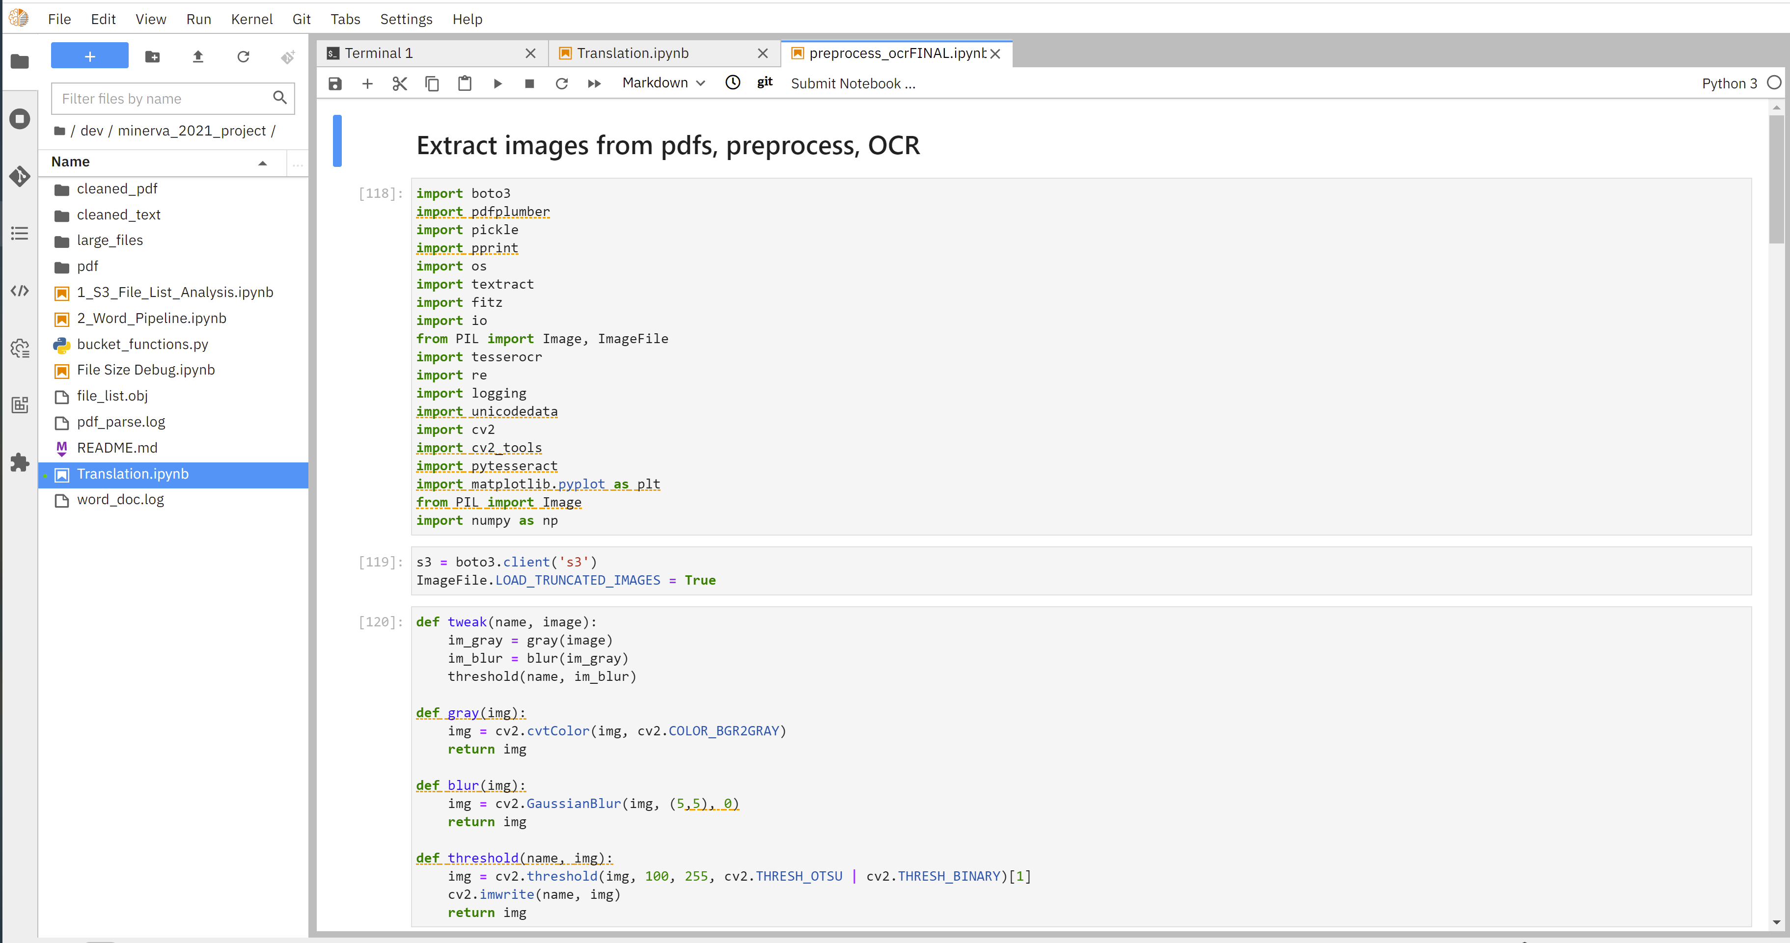
Data Processing
PDF - OCR

Slide 15
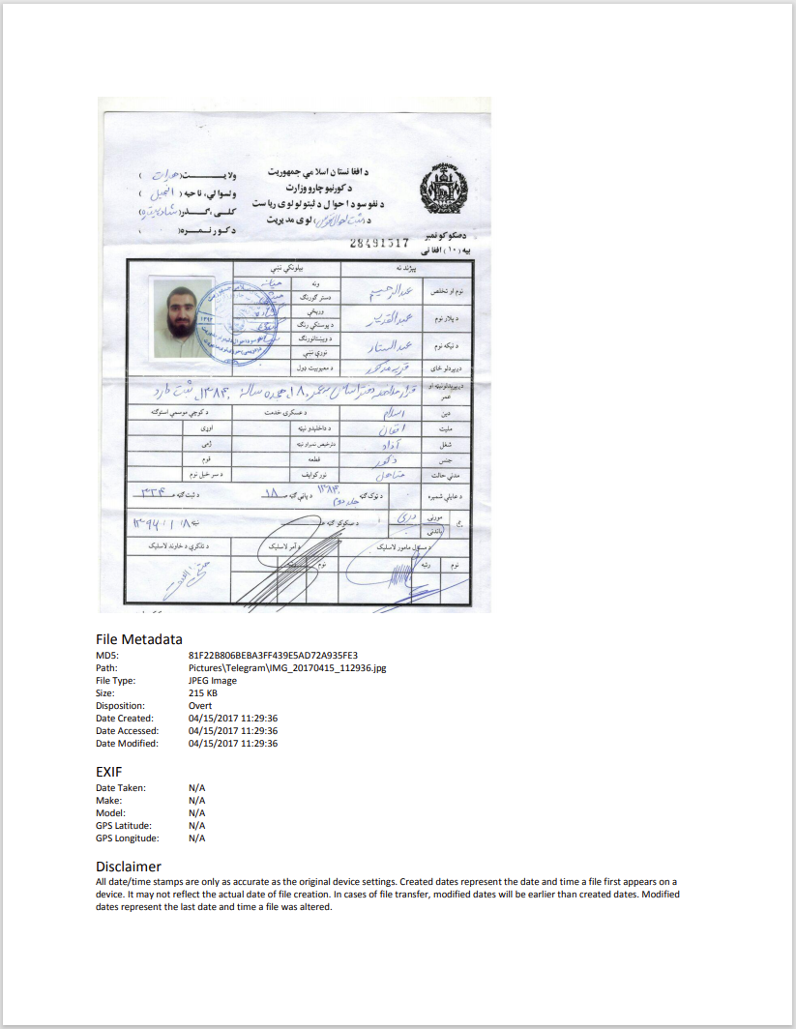
PDF Parsing
Data corpus includes 4,702 PDFs of varying length, quality, and content
File variation precludes application of single parsing COA
Variation also necessitates use of multi-step, multi-layer approach
Text extract (textract)
Photo extract & OCR (tesseract)
Example PDF

Slide 16
Text Extraction
File Metadata MD5: Path: File Type: Size: Disposition: Date Created: Date Accessed: Date Modified: 81F22B806BEBA3FF439E5AD72A935FE3 Pictures\Telegram\IMG_20170415_112936.jpg JPEG Image 215 KB Overt 04/15/2017 11:29:36 04/15/2017 11:29:36 04/15/2017 11:29:36 EXIF Date Taken: Make: Model: GPS Latitude: GPS Longitude: N/A N/A N/A N/A N/A Disclaimer All date/time stamps are only as accurate as the original device settings. Created dates represent the date and time a file first appears on a device. It may not reflect the actual date of file creation. In cases of file transfer, modified dates will be earlier than created dates. Modified dates represent the last date and time a file was altered.

Slide 17
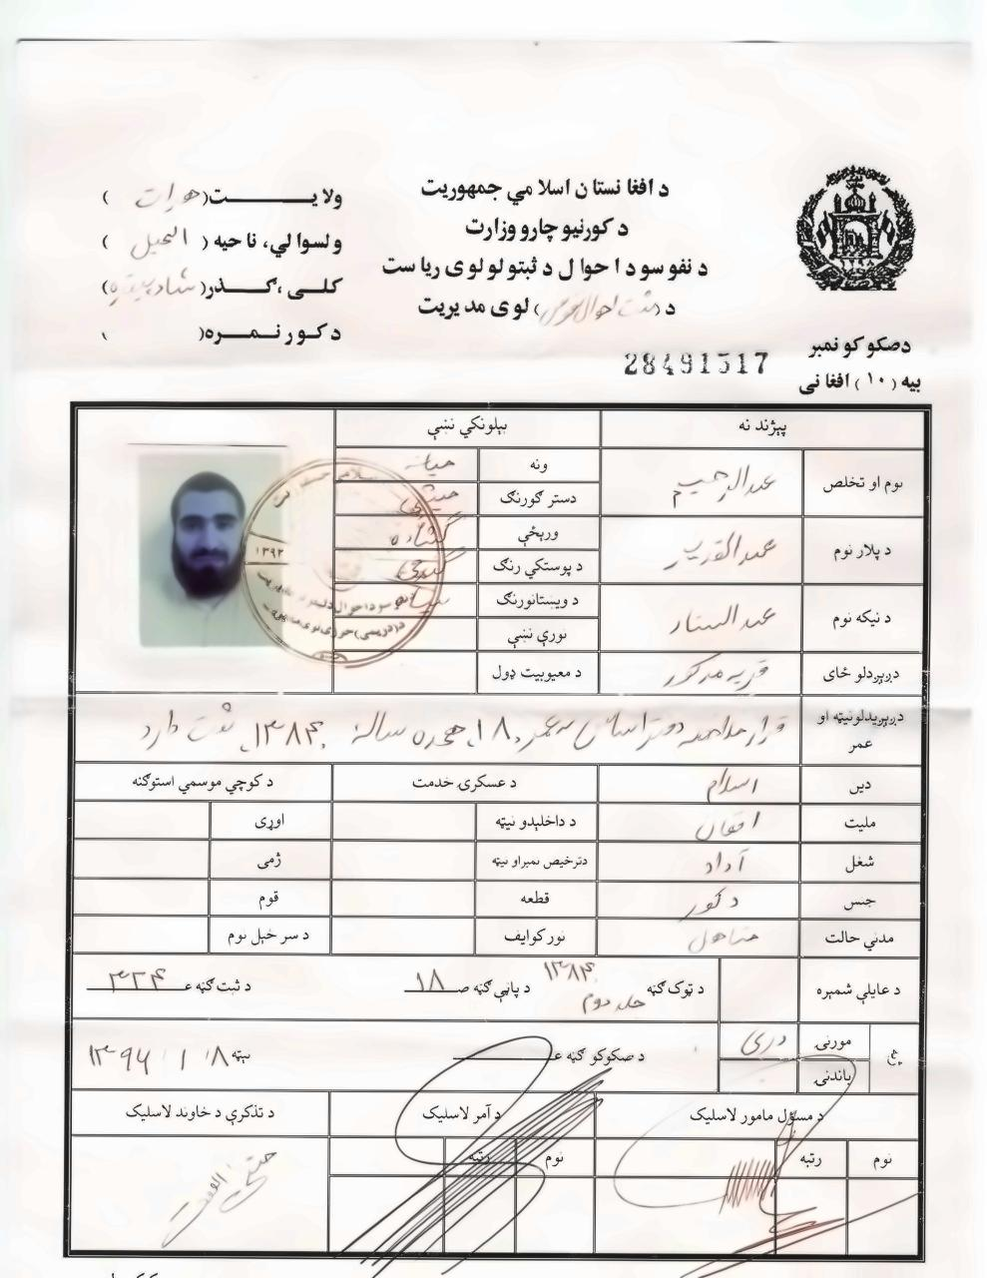
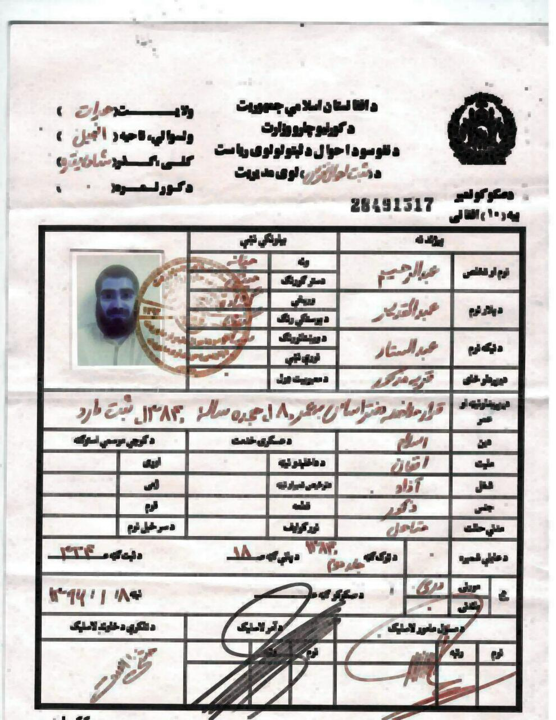
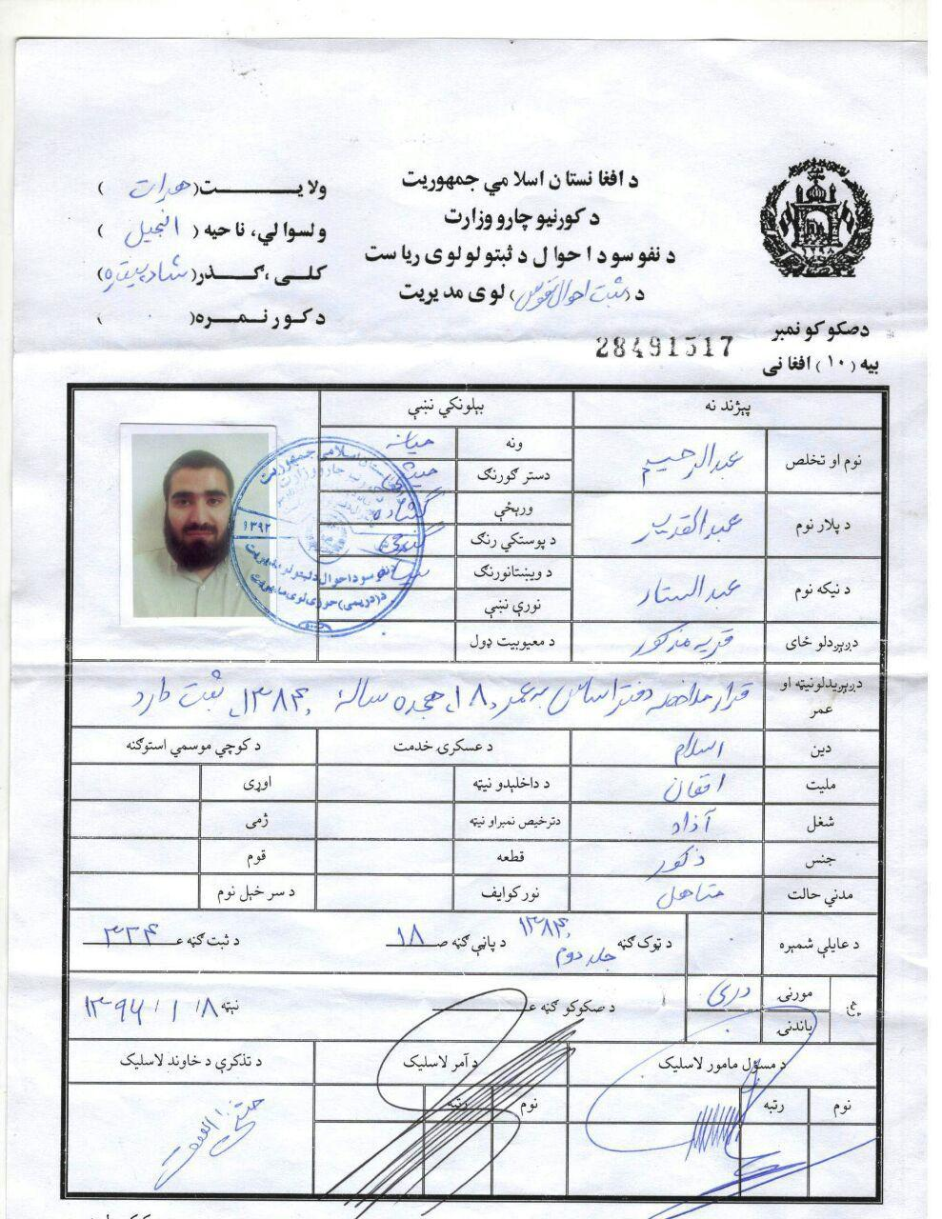
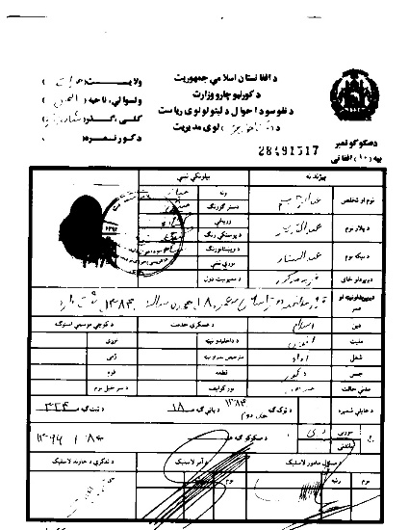
image Processing using OCR
Image Preprocessing
د افنا نستان اسلا مي جمهوريت ول 5 ‎i cle‏
د كورنيو جارو وزارت ولسوا لي. نا حيه ( ‎ot!‏ ¢‘
‎t‏ . . 2
د الوسود ! حوال د لبنولولوى رياس ‎yh gel?‏ مات 3
دد حارم ؛لوى مد يريت 3
دصك و كو نعبر 17 د كور تتمسرط ‎٠‏
‏2
[ne
CTY phn |
weer | (mA ee |
« | ‏معط هيك‎
Goer |
Noise Removal
Skinning & Skeletonization
Extracted Photo
Binarization

Slide 18
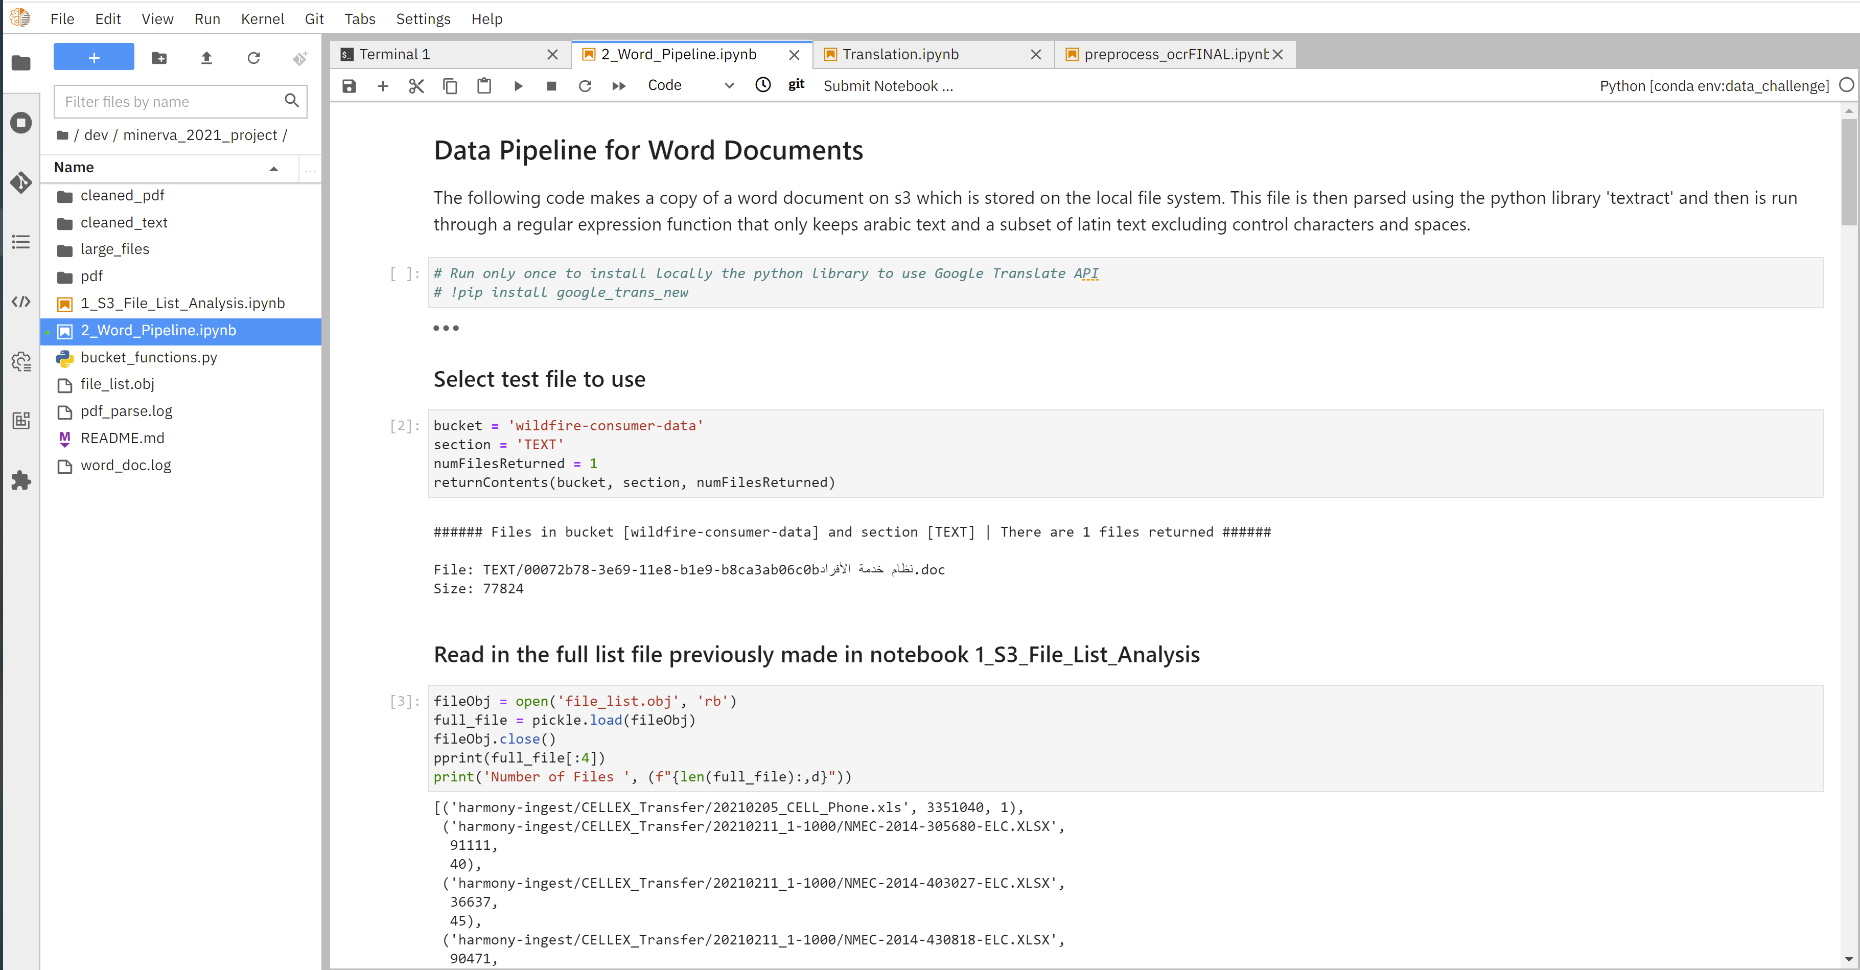
Data Processing
MS Word

Slide 19
MS word Processing
Data corpus includes 10,086 unique MS Word files (de-duped by filename) totaling just under 4GBs.
Files were selected if they had any Arabic in them
Text extraction using “textract” python library
All files were cleaned using regex to eliminate any non-Arabic or non-Latin (English) characters.
t_arabic = re.sub(r'[^\u0021-\u007e
\u0600-\u06ff\u0750-\u077f\ufb50-\ufbc1\ufbd3-\ufd3f\ufd50-\ufd8f\ufd50-\ufd8f\ufe70-\ufefc\uFDF0-\uFDFD]+', ' ', s)
Arabic (0600–06FF, 255 characters)
Arabic Supplement (0750–077F, 48 characters)
Arabic Extended-A (08A0–08FF, 84 characters)
Arabic Presentation Forms-A (FB50–FDFF, 611 characters)
Arabic Presentation Forms-B (FE70–FEFF, 141 characters)
Rumi Numeral Symbols (10E60–10E7F, 31 characters)
Indic Siyaq Numbers (1EC70–1ECBF, 68 characters)
Ottoman Siyaq Numbers (1ED00–1ED4F, 61 characters)
Arabic Mathematical Alphabetic Symbols (1EE00–1EEFF, 143 characters)
Latin (English) chars (0021-007f)

Slide 20
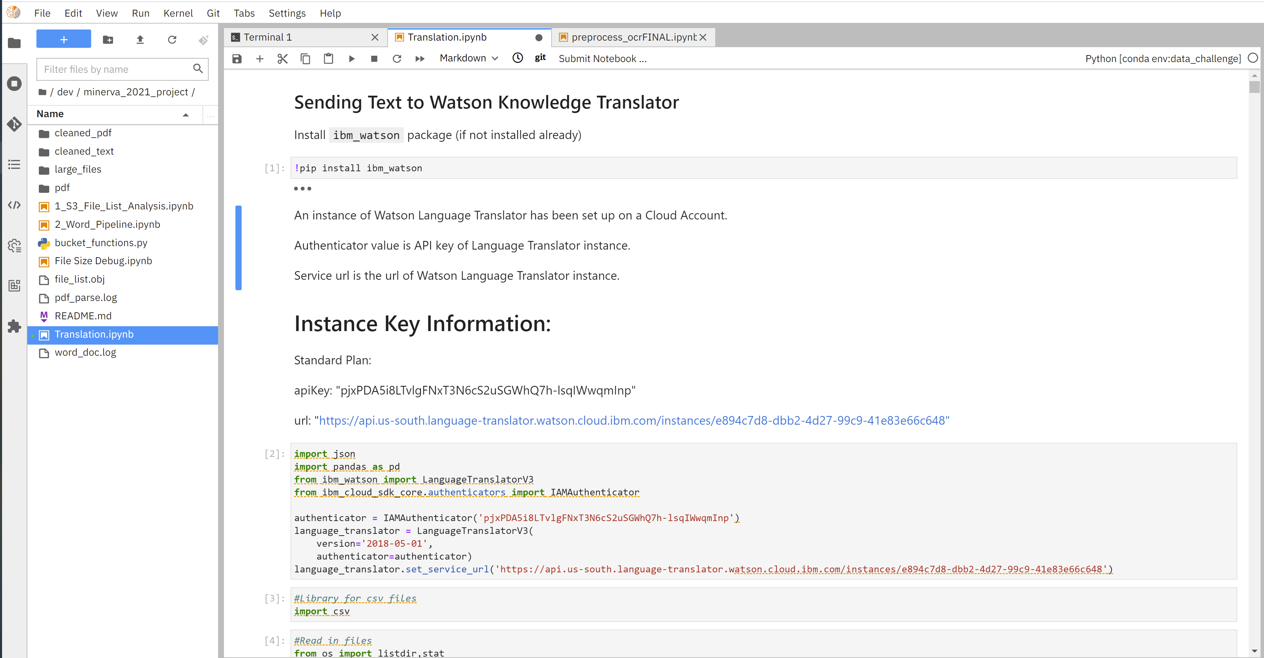
Language Translator
Arabic -> English

Slide 21
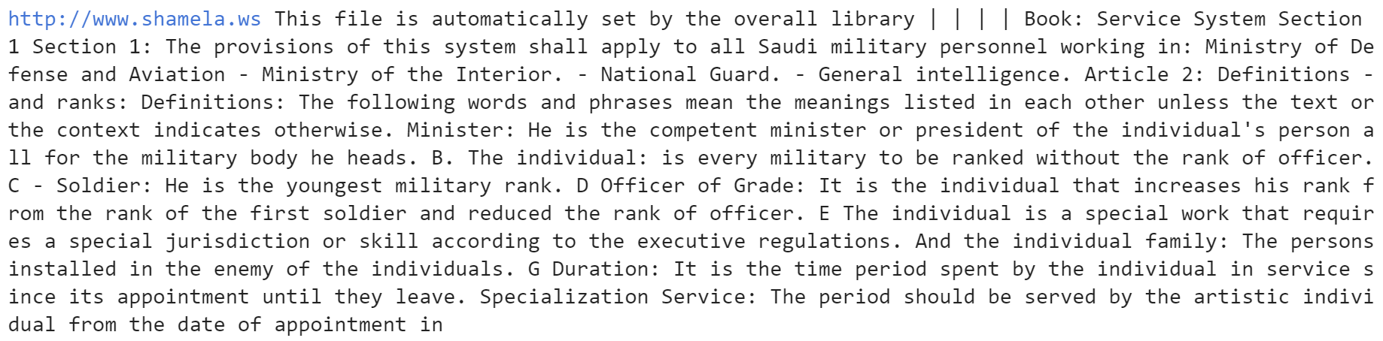
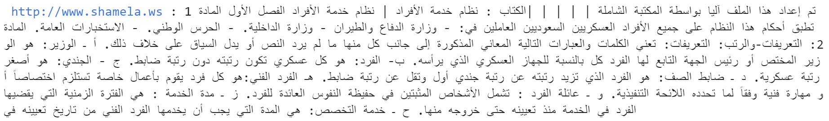
English to Arabic translation
Variety of Tools
Evaluated tools for efficient and accurate translation available to the team
Google Translate
BERT Translation model for Arabic to English
IBM Watson Knowledge Translator
Raw text required pre-processing
Remove all non-Arabic and non-Latin Unicode UTF-8 chars
Straight text
Understood the content loss due to formatting, tables, and images in documents
Data batches of 50KBs

Slide 22
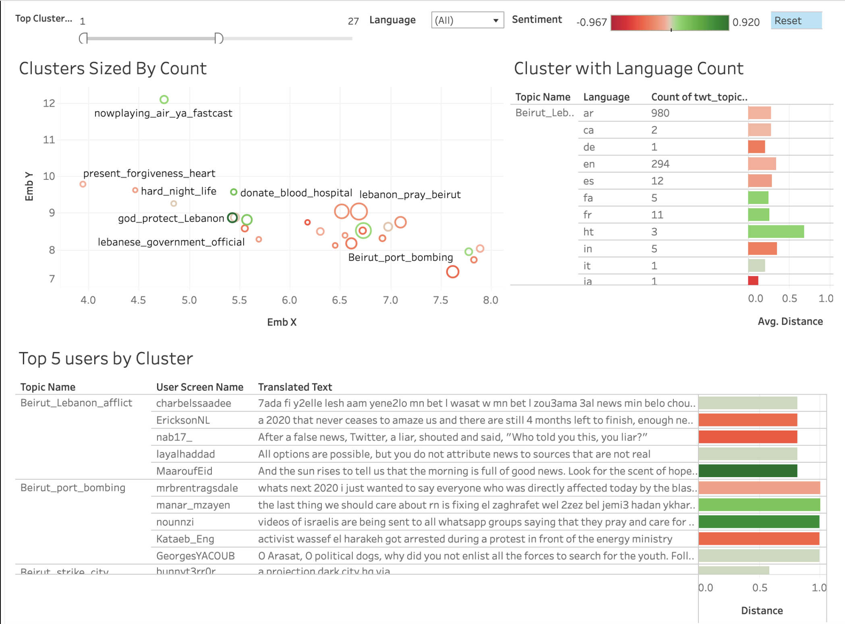
Topic Modeling
DEMO

Slide 23
UNCLASSIFIED
UNCLASSIFIED Backup follows
UNCLASSIFIED

Slide 24
APPROACH TBD DEMO
To Addressing the Use Case
Data preprocessing: gathering of machine learning data
Used existing challenge data on Wildfire
Parse Word and Excel, OCR’ed PDFs
Building datasets
Perform data exploration, parsing and vectorization
Cleaned all Arabic documents to straight Unicode files
Training and refinement
Translated the full dataset into English
Machine learning
Unsupervised and pre-trained models to identify topic, emotions, toxicity…
Evaluation
Reviewed models for bias, robustness, and optimization

